Slide 1
GRAPHS

Slide 2
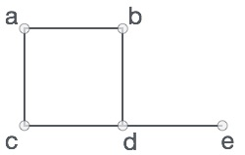
GRAPHS: -A Graph is a non-linear data structure consisting of nodes and edges. -The nodes are sometimes also referred to as vertices and the edges are lines or arcs that connect any two nodes in the graph. -G=<V,E> -V = {a, b, c, d, e} -E = {ab, ac, bd, cd, de}

Slide 3

Adjacency: A vertex is said to be adjacent to another vertex if there is an edge connecting them. Adjacent nodes are any two nodes that are connected by an edge.

Slide 4

Incident
If <1,2> is an edge in a directed graph
1 is adjacent to 2, and 2 is adjacent from 1
The edge <1,2> is incident on 1 and 2

Slide 5
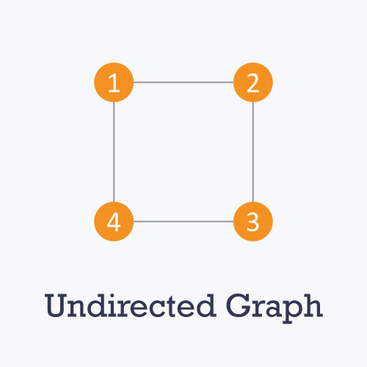
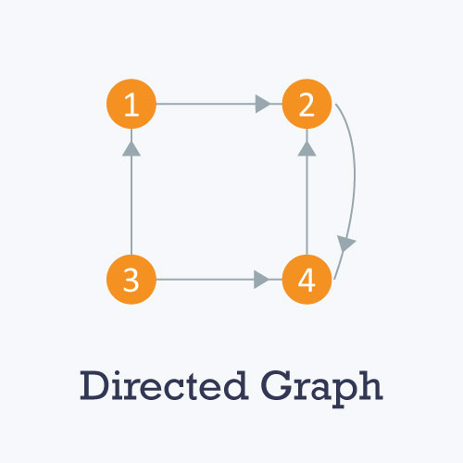
Types of graphs -Undirected: An undirected graph is a graph in which all the edges are bi-directional i.e. the edges do not point in any specific direction. -Directed: A directed graph is a graph in which all the edges are uni-directional i.e. the edges point in a single direction.

Slide 6
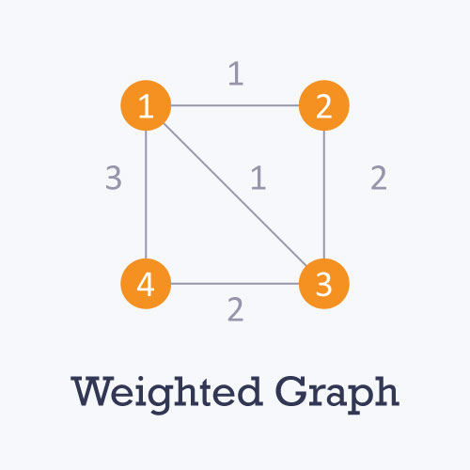
Weighted: In a weighted graph, each edge is assigned a weight or cost.

Slide 7
Complete Graph
A complete graph is a graph that has the maximum number of edges
for undirected graph with n vertices, the maximum number of edges is n(n-1)/2
for directed graph with n vertices, the maximum number of edges is n(n-1)
example: G1 is a complete graph

Slide 8
Examples for Graph
0
0
0
1
2
1
2
1
3
3
4
5
6
G1
2
G2
complete graph
incomplete graph
G3
V(G1)={0,1,2,3} E(G1)={(0,1),(0,2),(0,3),(1,2),(1,3),(2,3)}
V(G2)={0,1,2,3,4,5,6} E(G2)={(0,1),(0,2),(1,3),(1,4),(2,5),(2,6)}
V(G3)={0,1,2} E(G3)={<0,1>,<1,0>,<1,2>}
complete undirected graph: n(n-1)/2 edges
complete directed graph: n(n-1) edges

Slide 9
Figure 6.3
0
0
2
1
3
1
2
self edge
multigraph:
multiple occurrences
of the same edge

Slide 10
Subgraph and Path
A subgraph of G is a graph G’ such that V(G’) is a subset of V(G) and E(G’) is a subset of E(G).
Path: A sequence of edges that allows you to go from vertex A to vertex B is called a path. 0-1, 1-2 and 0-2 are paths from vertex 0 to vertex 2.
A path from vertex vp to vertex vq in a graph G, is a sequence of vertices, vp, vi1, vi2, ..., vin, vq, such that (vp, vi1), (vi1, vi2), ..., (vin, vq) are edges in an undirected graph.
The length of a path is the number of edges on it.

Slide 11
0
0
0
1
2
0
1
2
1
2
3
1
2
3
3
G1
(i) (ii) (iii) (iv)
(a) Some of the subgraph of G₁
0
0
0
0
0
1
1
1
1
2
2
2
(i) (ii) (iii) (iv)
(b) Some of the subgraph of G₃
G3

Slide 12
Simple Path and Cycle
A simple path is a path in which all vertices, except possibly the first and the last, are distinct.
A cycle is a simple path in which the first and the last vertices are the same.
In an undirected graph G, two vertices, v0 and v1, are connected if there is a path in G from v0 to v1
An undirected graph is connected if, for every pair of distinct vertices vi, vj, there is a path from vi to vj

Slide 13
tree (acyclic graph)
Connected cyclic
0
0
1
2
1
2
3
3
4
5
6
G1
G2

Slide 14
Degree
The degree of a vertex is the number of edges incident to that vertex
For directed graph,
the in-degree of a vertex v is the number of edges that have v as the head
the out-degree of a vertex v is the number of edges that have v as the tail

Slide 15
undirected graph
degree
3
0
0
2
1
2
3
1
2
3
3
3
3
4
5
6
3
3
1
G1
1
G2
1
1
0
in:1, out: 1
directed graph
in-degree
out-degree
1
in: 1, out: 2
2
in: 1, out: 0
G3

Slide 16
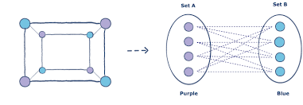
BIPARTITE GRAPH: A bipartite graph also called a bi-graph, is a set of graph vertices, i.e, points where multiple lines meet, decomposed into two disjoint sets, meaning they have no element in common, such that no two graph vertices within the same set are adjacent.

Slide 17
Graph Representations
Adjacency Matrix
Adjacency Lists

Slide 18
Adjacency matrix An adjacency matrix is a VxV binary matrix A. Element Ai,j is 1 if there is an edge from vertex i to vertex j else Ai,j is 0. Adjacency List: Linked list representation. Every node is linked to its own list that contains the names of all other nodes that are adjacent.

Slide 19
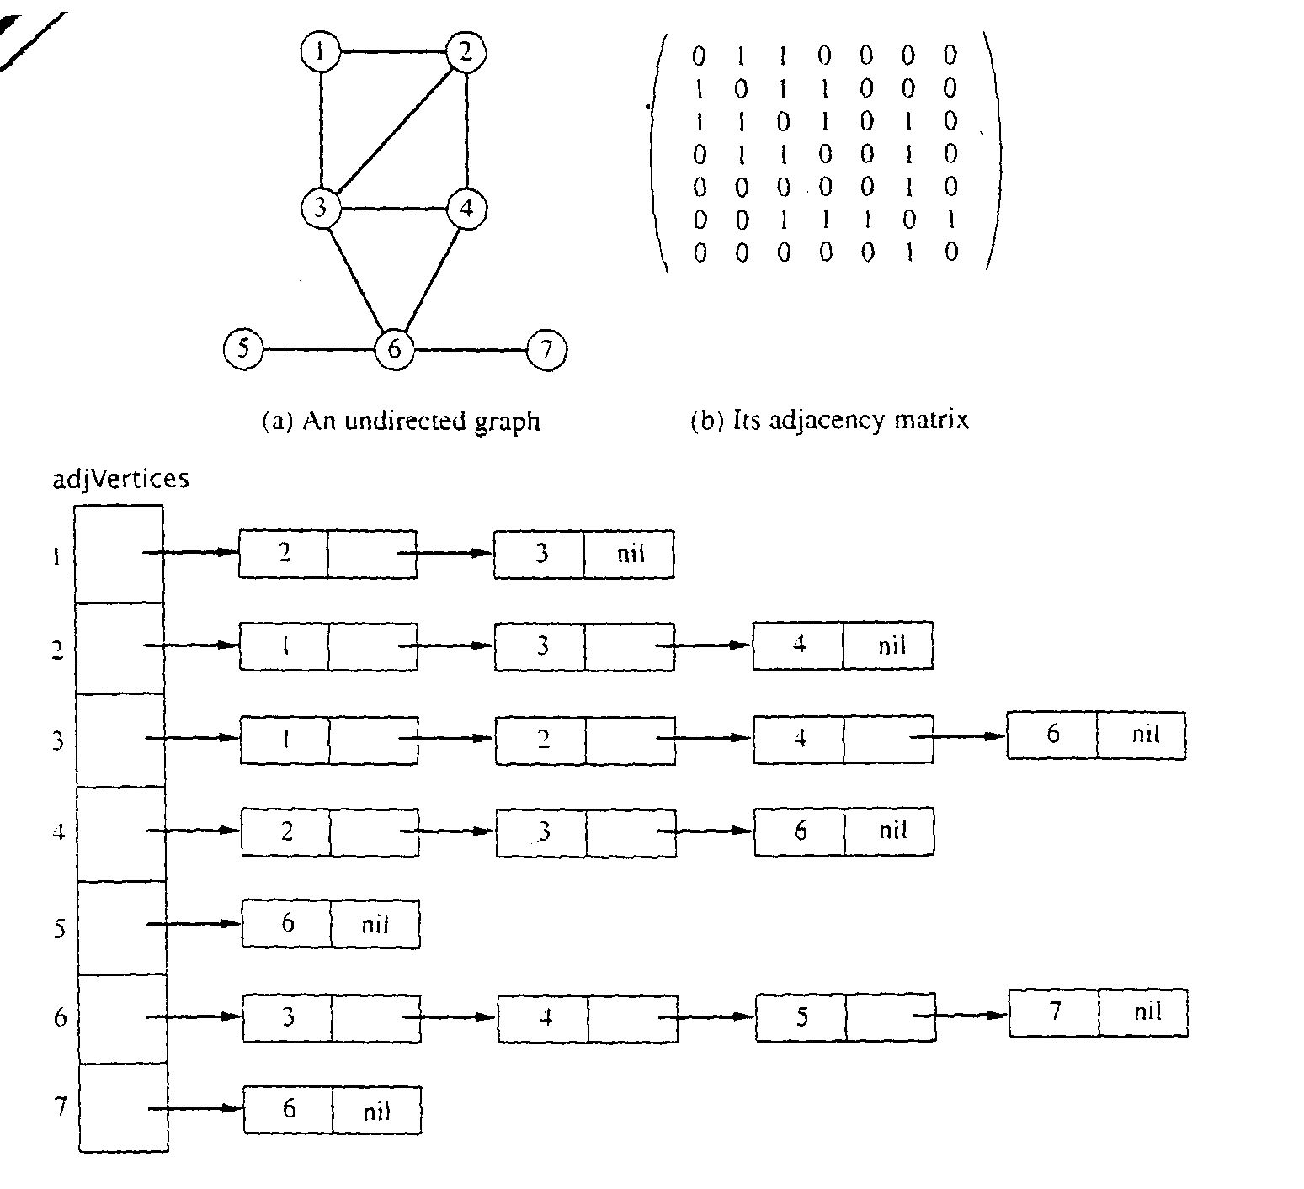
Adjacency Matrix Representation
Let G = (V,E), n = |V|, m = |E|, V = {v1, v2, …, vn)
G can be represented by an n × n matrix

Slide 20
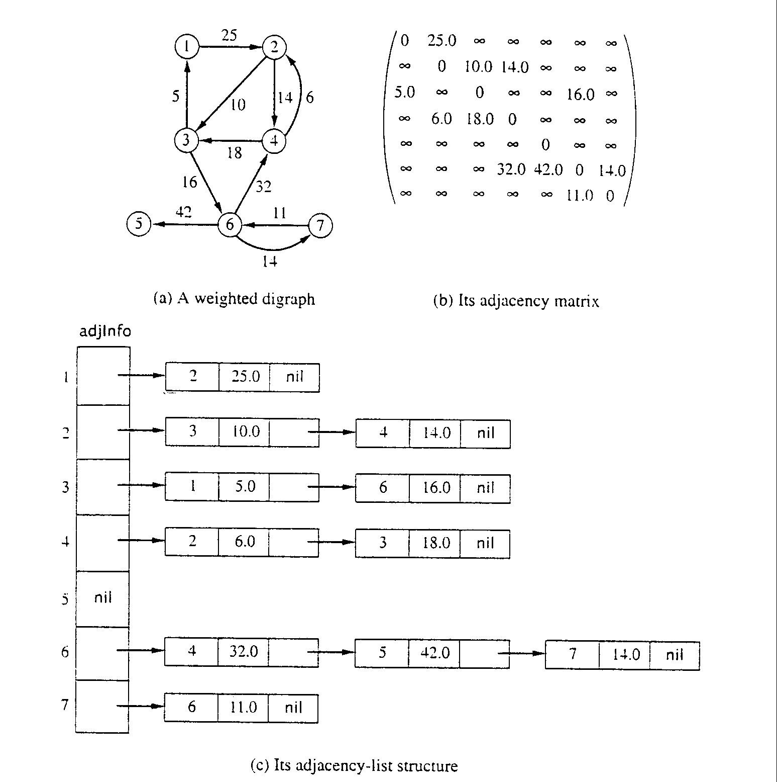
Adjacency Matrix for weight digraph

Slide 21
Array of Adjacency Lists Representation

Slide 22
Array of Adjacency Lists Representation

Slide 23
Graph Traversal Algorithms: -Traversing a graph means examining the nodes and edges of the graph. --Breadth First Search (Queue) --Depth First Search(Stack)

Slide 24
Breadth First Search (BFS) -The Breadth First Search (BFS) traversal is an algorithm, which is used to visit all of the nodes of a given graph. -In this traversal algorithm one node is selected and then all of the adjacent nodes are visited one by one. -After completing all of the adjacent vertices, it moves further to check another vertices and checks its adjacent vertices again. -Time complexity:O(V+E)

Slide 25
PROCEDURE: 1.Create a queue to put vertices and an array to mark visited vertices. 2.Insert the starting vertex into queue and visited array. 3.Do the below given process till the queue becomes empty: a)Remove the first vertex of the queue. b)Mark that vertex as visited. c)Insert all the unvisited neighbours of the vertex into the queue.

Slide 26
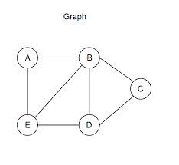
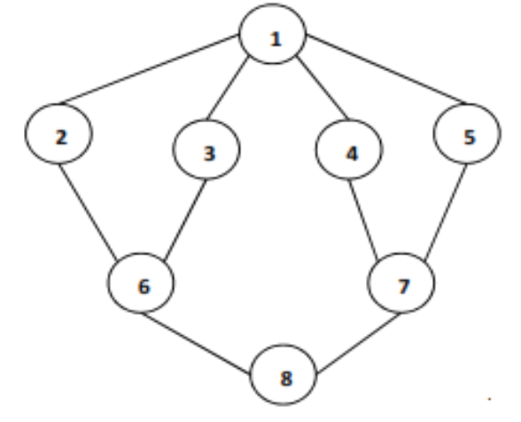
Perform BFS on the given graph

Slide 27
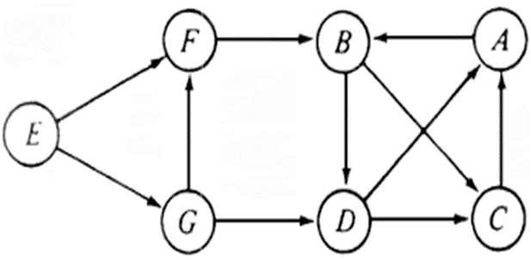

Slide 28
APPLICATIONS: 1) Shortest Path and Minimum Spanning Tree for unweighted graph 2) Peer to Peer Networks 3) Crawlers in Search Engines 4) Social Networking Websites 5) GPS Navigation systems 6) Broadcasting in Network 7) In Garbage Collection 8) Cycle detection in undirected graph 9) Ford–Fulkerson algorithm 10) To test if a graph is Bipartite 11) Path Finding between two vertices. 12) Finding all nodes within one connected component

Slide 29
Depth First Search (DFS) -The Depth First Search (DFS) is a graph traversal algorithm. -In this algorithm one starting vertex is given, and when an adjacent vertex is found, it moves to that adjacent vertex first and try to traverse in the same manner. -Discovery edges -Back edges -Time complexity:O(V+E)

Slide 30
PROCEDURE: Create a Stack and push the starting vertex to stack. 1. Visit the adjacent unvisited vertex. Mark it as visited. Display it. Push it in a stack. 2.If no adjacent vertex is found, pop up a vertex from the stack. It will pop up all the vertices from the stack, which do not have adjacent vertices. 3.Repeat 1 and 2 until the stack is empty.

Slide 31
Perform DFS on the given graph

Slide 33
APPLICATIONS OF DFS: 1) For a weighted graph, DFS traversal of the graph produces the minimum spanning tree and all pair shortest path tree. 2) Detecting cycle in a graph 3) Path Finding 4) Topological Sorting 5) To test if a graph is bipartite 6) Finding Strongly Connected Components of a graph 7) Solving puzzles with only one solution

